Slide 1

Winning Camp
UNDER SUPERVISION OF:
MS GAGANDEEP KAUR
(ASSISTANT PROFESSOR)
CHANDIGARH UNIVERSITY
PRESENTED BY:
NAME: CHANDER DEEP
UID:21MCA2132
SECTION: MCA11

Slide 2
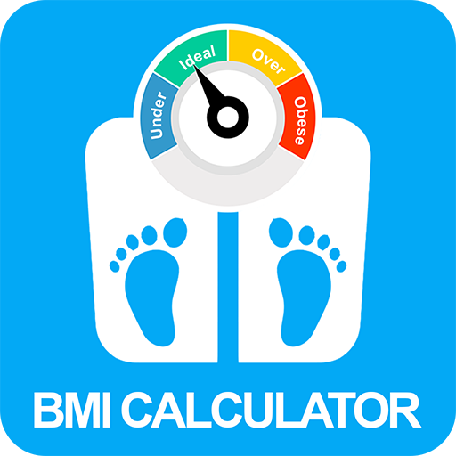
BMI CALCULATOR

Slide 3
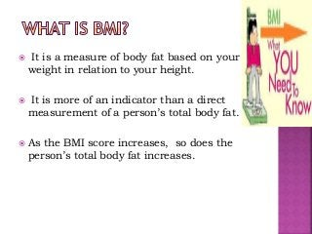
What is BMI
A BMI calculator is an online or offline device which measures your body mass index. The body mass index or BMI is a measure of how much body mass you have in relation to your height and weight.
Body mass refers not only to the fat within your body but also within muscles and bones. It is calculated by taking your weight and dividing it by the square of your height. The BMI figures let you know whether you are within normal weight range, or if you are underweight or overweight.
Both high BMIs and low ones are known to raise a host of health problems, especially as you age. However, a high BMI in itself is not always, medically speaking, a cause for alarm. It should be viewed in conjunction with other health parameters.

Slide 4
How to calculate BMI
To find out if your BMI or someone else’s BMI, the calculation process is simple. You can do this yourself by using a handheld calculator or do this online via websites or apps containing body mass index calculators.
To arrive at the result yourself, you simply divide your weight in kilograms by the square of your height in metres. Or simply input your height and weight in an app or website and the BMI results will flash on your screen.
If the numbers show that your BMI is above normal or below the normal range, you should get yourself checked by a doctor at least once every six months or at least once a year.
A number between 18.5 to 25 kg/m2 is considered normal BMI. Less than 15 is classified as very severely underweight, from 15 to 18 is categorized as underweight, from 25 to 30 is considered overweight. From 30 to 40 is classified as obese and above 40 as very severely obese.

Slide 5
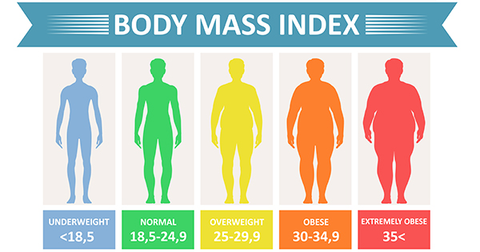
CATEGORYS OF BMI

Slide 6
Factor Affecting BMI
The clinical limitations of BMI should be considered. BMI is a surrogate measure of body fatness because it is a measure of excess weight rather than excess body fat. Factors such as age, sex, ethnicity, and muscle mass can influence the relationship between BMI and body fat. Also, BMI does not distinguish between excess fat, muscle, or bone mass, nor does it provide any indication of the distribution of fat among individuals. The following are some examples of how certain variables can influence the interpretation of BMI: • On average, older adults tend to have more body fat than younger adults for an equivalent BMI. • On average, women have greater amounts of total body fat than men with an equivalent BMI. • Muscular individuals, or highly-trained athletes, may have a high BMI because of increased muscle mass.

Slide 7
Technology
Python is a high-level, interpreted, interactive and object-oriented scripting language. Python is designed to be highly readable. It uses English keywords frequently where as other languages use punctuation, and it has fewer syntactical constructions than other languages.
Python Tkinter: Tkinter is the standard GUI library for Python. Python when combined with Tkinter provides a fast and easy way to create GUI applications. Tkinter provides a powerful object-oriented interface to the Tk GUI toolkit.

Slide 8
SCOPE
The major goal is to keep one's health in good shape. The BMI Calculator provides us with all of the necessary information, such as health recommendations and advice on what to eat and what to avoid. When we enter our height and weight, we are given all relevant information, such as if we are overweight or underweight.

Slide 9
Future Aspects
1.In future we can give user heathy diet according to BMI.
2.Exercise routine with health status.
3.User can save their BMI data for future .

Slide 10
Thank You

